Slide 1
Four-Legged Bluetooth- Controlled Spider Robot
Name: Chandra Manaswitha
Regno: 192225050

Slide 2

LinkedIn Article: Four Legged Spider Robot
Summary :
The Bluetooth-Controlled Four-Legged Spider Robot is a compact, creative, and educational robotic project designed to introduce students and hobbyists to the world of robotics and wireless control. Inspired by the natural movement of spiders, this robot simulates legged locomotion using just 2 BO motors, a clever linkage mechanism, and a lightweight chassis, making it efficient yet dynamic. At its core, the bot features an Arduino Nano, an HC-05 Bluetooth module, and an L298N motor driver, allowing users to send movement commands—forward, backward, rotate left, and right—directly from a smartphone using a Bluetooth terminal app. Powered by three 18650 batteries and designed with modular, 3D-printed components, it can smoothly navigate on various surfaces, from classroom floors to tabletops. This spider bot isn’t just about motion—it’s a hands-on educational tool that fosters STEM learning, creativity, and curiosity. Easy to build, affordable, and expandable with future add-ons like sensors or autonomous features, it serves as a perfect learning platform for students, makers, and robotics enthusiasts. Combining mechanical innovation with wireless control, the Spider Robot brings code to life—one leg at a time.
https://www.linkedin.com/pulse/four-legged-bluetooth-controlled-spider-robot-manaswitha-chandra-g4r4c

Slide 3
Problem Identification
There is a lack of low-cost, interactive robots that teach robotics through Bluetooth-controlled legged movement in a fun and engaging way.
Production & Launch
Research & Ideation
The final prototype was optimized for cost and ease of assembly, and prepared for launch through educational demos, workshops, and classroom integration.
We researched simple walking mechanisms and ideated a Bluetooth-controlled spider robot using two motors to create an affordable and interactive learning tool.
Testing & Refinement
Design & Prototyping
The robot was tested on various surfaces to check movement accuracy and Bluetooth response, and refined for better stability, speed control, and user experience.
The robot was designed with a lightweight chassis and linkage system, and prototyped using Arduino Nano, BO motors, and Bluetooth control for smooth multi-legged movement.

Slide 4
Problem
Most educational robots use wheels and expensive components, making them less engaging and less affordable for students.
There is a need for a low-cost, Bluetooth-controlled legged robot that encourages hands-on learning and interactive play.
Existing robots often struggle on uneven surfaces, limiting their usability—therefore, a spider-like walking mechanism can offer better surface adaptability.
Solution
The Spider Robot addresses common challenges in educational robotics by offering a budget-friendly, Bluetooth-controlled, and visually engaging solution. Designed to simulate natural walking movement using just two motors, it enhances hands-on learning and interactive control in classroom and home environments.
Size: Compact and lightweight design that fits easily on desks, floors, and learning stations.
Design: Sturdy leg-based structure with a simple mechanical linkage system for smooth walking; safe and approachable for students.
Functionality: Moves forward, backward, and rotates left/right through smartphone Bluetooth commands using a mobile app (Serial Bluetooth Terminal).
Use Cases: Perfect for robotics education, personal STEM projects, hobby robotics, classroom demonstrations, and experimentation on various surfaces.

Slide 5
Problem Statement
In today’s learning environments, educational robots are becoming popular tools to teach programming, electronics, and mechanical design. However, most of these robots rely on wheels for movement, which limits both their physical interactivity and their ability to simulate real-world walking mechanisms.
Additionally, many such platforms are costly, involve complex assembly, and are often not adaptable to different types of surfaces, restricting their use to flat, smooth floors. This makes it difficult for students and beginners to explore true robotic motion, especially in budget-constrained educational institutions or rural areas.
Furthermore, many robots lack wireless control options and depend on external PCs or tethered setups, which reduces portability and hands-on engagement during classroom activities. There is a growing need for a simple, cost-effective, Bluetooth-controlled robot that can demonstrate legged locomotion using minimal hardware, while still being engaging, easy to build, and capable of moving on varied indoor surfaces.
The Bluetooth-Controlled Four-Legged Spider Robot addresses these issues by offering a low-cost, programmable, and app-controlled platform that mimics spider-like walking with only two motors—ideal for students, hobbyists, and educators alike.

Slide 6
User Needs
Students, educators, and hobbyists need affordable, hands-on tools that make learning robotics both engaging and accessible. Most existing platforms are either expensive, too complex for beginners, or limited to wheel-based motion. Users are looking for a robot that is simple to assemble, easy to program, and fun to operate—especially one that simulates walking using legged movement rather than traditional wheels. They also expect the robot to work on different surfaces like classroom floors, tiles, or wood without getting stuck, making it more versatile for real-world testing and demonstration.
In addition, users want wireless control options like Bluetooth to operate the robot remotely through a mobile app, making the experience more interactive and less restricted by cables or external hardware. Portability is also a key need, as educators often move tools between classrooms or learning sessions. The ideal robot should also support future expansion—such as adding sensors or automation—so that learners can keep building on the same platform as their skills grow. Overall, there is a strong demand for a cost-effective, mobile, and interactive spider robot that blends mechanical creativity with digital control in a fun and educational way.

Slide 7
Roles and Responsibilities
Role | Responsibilities
Project Designer | Designed the robot’s overall structure, leg mechanism, and placement of all key components.
Embedded Systems Developer | Programmed the Arduino Nano for motor control, Bluetooth command handling, and input logic.
Hardware Assembler | Assembled BO motors, motor driver (L298N), HC-05 Bluetooth module, battery holder, and wiring.
Bluetooth App Integrator | Configured and tested the Serial Bluetooth Terminal app to wirelessly control robot movements.
Surface Tester | Verified movement on various surfaces (tile, wood, paper) and fine-tuned leg coordination.
Stability & Performance Debugger | Identified and fixed issues related to motion accuracy, turning, and Bluetooth responsiveness.
Documentation & Media Lead | Prepared all technical documents, diagrams, and presentation slides for academic review and display.

Slide 8
Gantt Chart
Task | Week 1 | Week 2 | Week 3 | Week 4 | Week 5 | Week 6 | Week 7 | Week 8 | Week 9 | Week 10
Requirement Identification | ✔️
Component Selection & Research |  | ✔️
Mechanical Design of Spider Structure |  |  | ✔️
Circuit Design & Wiring Plan |  |  |  | ✔️
Hardware Assembly (Motors, Legs, Chassis) |  |  |  |  | ✔️ | ✔️
Arduino Programming for Movement |  |  |  |  |  | ✔️
Bluetooth Module (HC-05) Integration |  |  |  |  |  |  | ✔️
Movement Testing on Multiple Surfaces |  |  |  |  |  |  |  | ✔️ | ✔️
Troubleshooting & Stability Adjustments |  |  |  |  |  |  |  |  | ✔️
Final Testing with Mobile App Control |  |  |  |  |  |  |  |  |  | ✔️

Slide 9
Understanding the user
User Persona 1 – The Robotics Educator
Name: Sruthi V
Age: 26
Occupation: STEM & Robotics Instructor
Location: Bengaluru, Karnataka, India
Needs & Challenges:
Sruthi needs a low-cost, easy-to-build robot to teach students mechanical movement and basic Arduino programming. She prefers Bluetooth control for wireless operation and wants a robot that walks smoothly on surfaces like tiles and wood. Modularity is important so it can be upgraded with sensors or new features over time.
Goals:
Sruthi aims to make robotics engaging and hands-on for students by using the four-legged spider robot to demonstrate key concepts. She wants to promote creativity, simplify learning, and build a platform that evolves with students’ skills and classroom needs..

Slide 10
User Persona 2 – The Student Enthusiast
Name: Nikhilesh Makkena
Age: 20
Occupation: B.Tech Student (2nd Year, ECE)
Location: Nellore, Andhra Pradesh, India
Needs & Challenges:
Nikhilesh wants a robotics project that is budget-friendly, exciting, and helps him learn Arduino, Bluetooth control, and motor functions. He looks for a robot that’s easy to assemble and debug without requiring advanced tools or soldering. He struggles to find legged robot kits that are beginner-friendly yet interesting enough for academic and personal projects.
Goals:
Nikhilesh hopes to improve his skills in embedded systems by building a functional walking robot he can showcase at tech fests or submit as a mini-project. He aims to explore Bluetooth-based control systems, learn more about hardware integration, and experiment with future upgrades like sensors or voice control.

Slide 11
COMPETITIVE ANALYSIS
Competitor Name | Price (INR) | Target Audience | Unique Value Proposition
Bluetooth-Controlled Spider Robot(My product) | ₹10,000 | Students, hobbyists | Walks using 2 BO motors, Bluetooth app-controlled, Arduino-based, surface-friendly
Quadruped Servo Robot Kit | ₹18,000 – ₹22,000 | Engineering students | Complex servo-based walking, 12 DOF, requires calibration, advanced coding
Robobloq Q-Elephant Robot | ₹19,500 | Ages 10–16 | Elephant-style walking robot, app & PC control, obstacle avoidance
Lego Mindstorms EV3 | ₹35,000 – ₹50,000 | High school students | Premium coding and motion platform, sensors, multiple motors, modular
Makeblock mBot Ranger | ₹21,000 | Ages 10+ | 3-in-1 robot (tank, 2-wheeler, upright), graphical coding, Bluetooth control

Slide 12
COMPETITIVE ANALYSIS
Competitor Name | Price (INR) | Target Audience | Unique Value Proposition
Tinkering Labs Electric Motors Catalyst | ₹14,500 | Ages 10–15 | DIY robotics with motors, wheels, mounts; no walking or Bluetooth feature
Stempedia Quarky Humanoid Robot | ₹16,000 | Ages 12+ | AI and robotics kit with gesture control, humanoid body, high-level coding
Hexapod Spider Robot Kit | ₹25,000 | Robotics enthusiasts | 6-legged, servo-powered walking spider, realistic motion, advanced
Zumi Self-Driving Robot Car | ₹17,000 | Senior school, colleges | Teaches AI + self-driving basics, has sensors and camera

Slide 13
Business Potential
The Bluetooth-Controlled Four-Legged Spider Robot presents strong business potential in the growing educational robotics and DIY electronics market. With its unique combination of affordability, real walking motion, Bluetooth control, and Arduino programmability, this product addresses the increasing demand for hands-on, screen-free learning experiences in schools, workshops, and maker communities. This robot is especially valuable for:
STEM education: Schools and colleges looking to incorporate interactive kits into robotics, electronics, and programming curricula.
DIY/Maker markets: Hobbyists, tech enthusiasts, and creators seeking customizable robotic kits for experimentation or showcases.
EdTech startups: As a prototype for a scalable low-cost educational robot that can be expanded with sensors, AI modules, or voice features.
The robot’s modularity allows for future upgrades, making it suitable for long-term learning and innovation. With proper branding, educational outreach, and bulk manufacturing, the product can be commercialized at a competitive price and positioned as an entry-level alternative to high-end robotic kits currently dominating the market.

Slide 14
Gap Analysis
Current State: Most walking robots for education are expensive, wheeled, or servo-based, with limited accessibility, mobility range, or practical classroom use.
Desired State: Develop a cost-effective, Bluetooth-controlled walking robot with leg-based motion, simple app commands, and compatibility with basic embedded systems for hands-on learning.
Affordability Gap: Popular legged robots and programmable kits are priced ₹15,000–₹40,000, making them unsuitable for bulk adoption in schools, workshops, or student projects.
Mobility Gap: Many educational robots rely on wheels, not legs, offering less realism in movement and limited usability on rough or uneven surfaces.
Technology Gap: There is a lack of Arduino-based, app-controlled robots that demonstrate realistic walking using minimal motors, especially ones that support Bluetooth over wired/IR control.
Solution: Introduce a low-cost, compact spider robot that uses just 2 BO motors for 8-leg movement, connects via Bluetooth for mobile app control, runs on Arduino Nano, and is adaptable for future sensor upgrades.

Slide 15
Target Audience
Students and Academic Projects - This robot is ideal for engineering and diploma students working on final year projects or participating in robotics competitions. It offers a practical way to understand Arduino programming, Bluetooth communication, and motor control using minimal components, making it perfect for academic learning.
Educators and Workshop Trainers - STEM educators and trainers can use this robot to conduct hands-on sessions that demonstrate the fundamentals of robotics in an engaging and affordable manner. Its simple design and functionality help bridge the gap between theoretical learning and real-world application.
Makers and DIY Enthusiasts - Hobbyists who enjoy building and customizing robots will find this project appealing due to its simplicity, upgradability, and spider-like walking motion. It provides an exciting platform for experimentation, sensor integration, and design modification.
Tech Events and EdTech Innovators - Robotics clubs, tech exhibitions, and ed-tech startups can adopt this robot as a showcase of creative engineering. Its mobility, interactivity, and cost-effectiveness make it suitable for interactive demos, learning kits, and educational outreach initiatives.

Slide 16
User Pain Points
High Cost of Educational Robot - Many programmable walking robots on the market are priced too high for students or educational institutions. This makes it difficult for schools and learners to access practical robotics tools within a limited budget.
Complexity of Assembly and Programming - Robots with multiple servos or advanced components often require complex coding and calibration, which can be overwhelming for beginners. Users struggle with lengthy setup times and steep learning curves, reducing hands-on engagement.
Limited Mobility and Surface Compatibility - Wheeled or static robots typically cannot operate well on uneven surfaces like cardboard or tiles. Users often find such robots unreliable in dynamic classroom environments where smooth operation across surfaces is necessary.
Lack of Wireless, App-Based Control - Some educational robots still rely on IR remotes or physical switches, limiting flexibility. Users expect Bluetooth or smartphone control for convenience, especially in modern classrooms or interactive demos.
Low Customizability for Future Use - Many low-cost robots are not designed for upgrades or sensor integration. Once built, they offer little scope for learning beyond basic movement, making them less valuable over time.

Slide 17
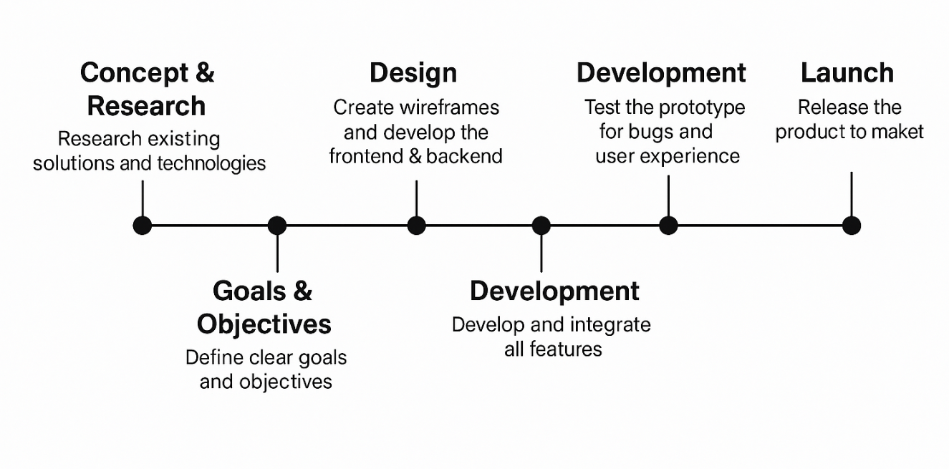
Prototyping & Ideation – Spider Robot

Slide 18
Low Fidelity Mockups
1. Ideation (Divergent Thinking)
Brainstormed various possibilities to create a cost-effective, Bluetooth-controlled spider robot that simulates walking while maintaining simplicity and educational value. Key features identified:
Bluetooth-Based Control – Controlled via mobile app (Serial Bluetooth Terminal), allowing wireless movement in all four directions.
Four-Legged Spider Design – Uses only two BO motors to drive mechanical legs, reducing cost and complexity.
Arduino Nano Integration – Acts as the main controller for Bluetooth commands and motor control logic.
All-Terrain Capability – Designed to walk over various surfaces like tile, cardboard, and wooden floors.
Expandability – Structure allows easy future upgrades like obstacle sensors or sound feedback modules.
2.Alternatives (Concept Variations)
Basic Version – A minimal design with Bluetooth app control, simple two-motor walking, and manual ON/OFF switching.
Intermediate Version – Includes LDR for light detection, battery level indicator using OLED, and fine-tuned movement coordination.
Advanced Version – Plans to integrate obstacle avoidance sensors, motion pattern customization, and voice feedback or gesture-based control.

Slide 19
3. Iterations (Refinement of Ideas)
1st Iteration: Basic Bluetooth movement tested using Serial Bluetooth Terminal app, controlled with simple forward, backward, left, and right commands.
2nd Iteration: Leg mechanism refined to ensure balanced movement using just 2 motors, and structure optimized for better grip and stability.
3rd Iteration: Tested enhanced features such as OLED display for system status, modular wiring for add-ons, and lightweight 3D-printed chassis design.
4. Learnings from Iterations
Two motors can successfully simulate spider-like motion with efficient linkage design.
Bluetooth control improves engagement and is easier for users than IR-based methods.
The robot performs best on smooth but varied surfaces, offering versatility.
Modular wiring and compact battery setup improve safety and portability.
Simple, remote-based interaction ensures usability even for non-technical users.
5. Low-Fidelity Mockups (Convergence Phase)
Robot Sketch: Top-down and side-view sketches illustrating motor placement, leg structure, Nano board mount, and battery housing.
App Control Diagram: Flowchart showing mobile app input → HC-05 Bluetooth → Arduino logic → Motor Driver (L298N) → Spider Leg Motion.
Mechanism Layout: Simplified mechanical linkage diagrams for how two motors coordinate to move all four legs on each side.

Slide 20
Usability Testing – Spider Robot
Round 01 – Usability Findings
Issue: Delay in response to Bluetooth commands
Observation: Users, especially students, expected immediate movement after sending commands
Solution: Improved Arduino code to reduce input lag and optimize Bluetooth signal handling
Issue: Movement wasn’t smooth on rough surfaces
Observation: Legs occasionally dragged or slipped, reducing mobility and excitement
Solution: Refined leg linkage and tested on multiple surface types to improve traction and motion
Issue: Bluetooth connection occasionally dropped
Observation: App disconnected when the phone was moved or idle for long
Solution: Updated power delivery and repositioned HC-05 for stronger signal retention
Round 02 – Usability Findings
Issue: Battery drained quickly with continuous movement
Observation: Users had to frequently recharge after short use periods
Solution: Optimized code to reduce idle motor power and improved battery wiring efficiency
Issue: Confusion in app control layout
Observation: First-time users often pressed wrong buttons or misinterpreted directions
Solution: Added control guide in app description and improved labeling in interface
Issue: Imbalance at high speed or sharp turns
Observation: Robot tipped or wobbled on corners or smooth flooring
Solution: Adjusted speed limits and widened chassis base using broader free-wheel placement

Slide 21
Parts Lookup
S. No. | Component | Function / Description
1 | Spider Robot Chassis | Lightweight body supports mechanical legs, motors, and electronics
2 | BO Motors (2 × 60 RPM) | Drives all 8 legs through mechanical linkages, enabling spider-like motion
3 | HC-05 Bluetooth Module | Allows wireless control via smartphone (Serial Bluetooth Terminal app)
4 | Arduino (Uno/Nano) | Acts as the central controller for motor control and Bluetooth communication
5 | L298N Motor Driver | Controls direction and speed of BO motors based on Arduino signals
6 | 18650 Batteries (×3) | Power source for motors and logic circuit, placed in a battery holder
7 | Push Buttons | Manual input for starting/stopping or switching stories
8 | Mobile App (BT Serial) | Used to send commands (forward, back, left, right) to the robot wirelessly via Bluetooth
9 | Battery Holder | Safely holds and connects the batteries to the circuit

Slide 22
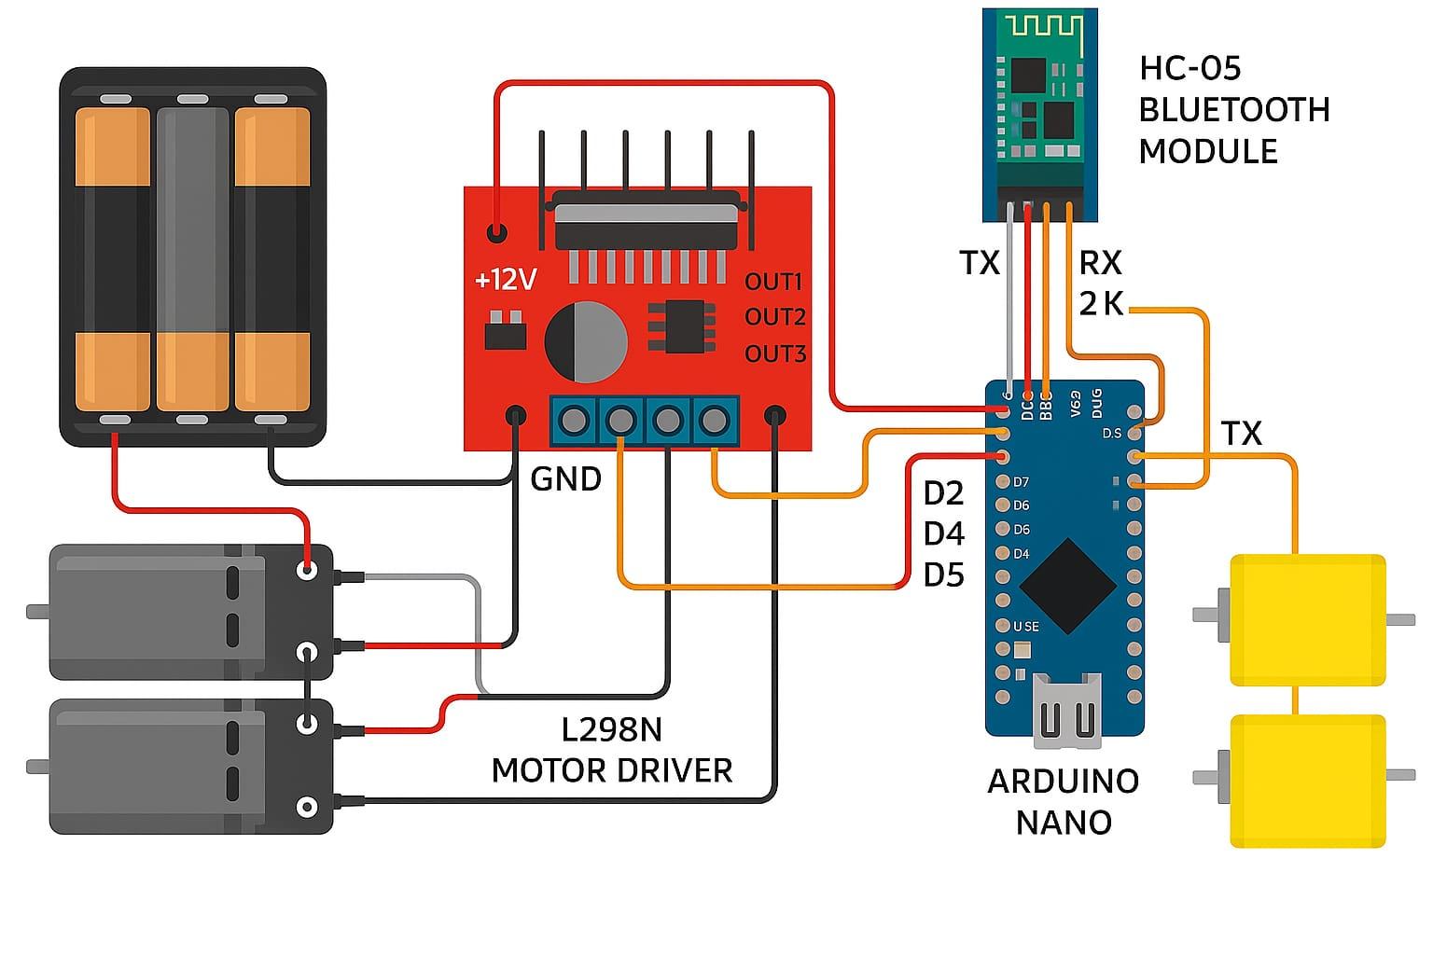
Circuit Diagram

Slide 23
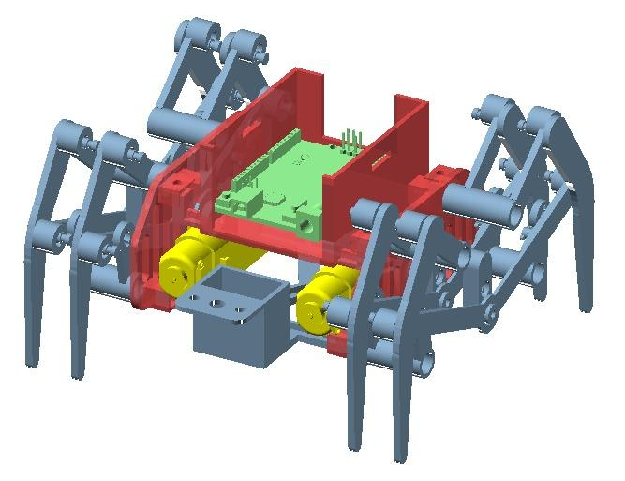
Mockup Low Fidelity

Slide 24
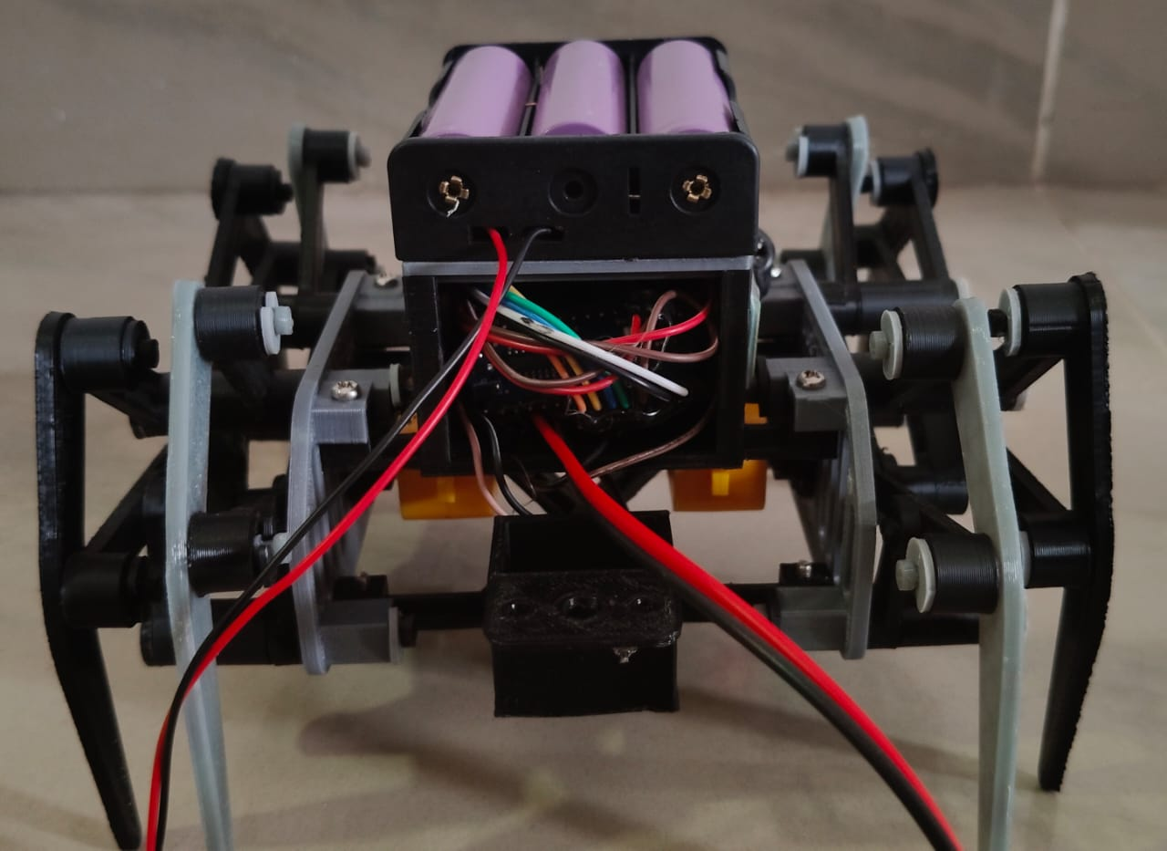
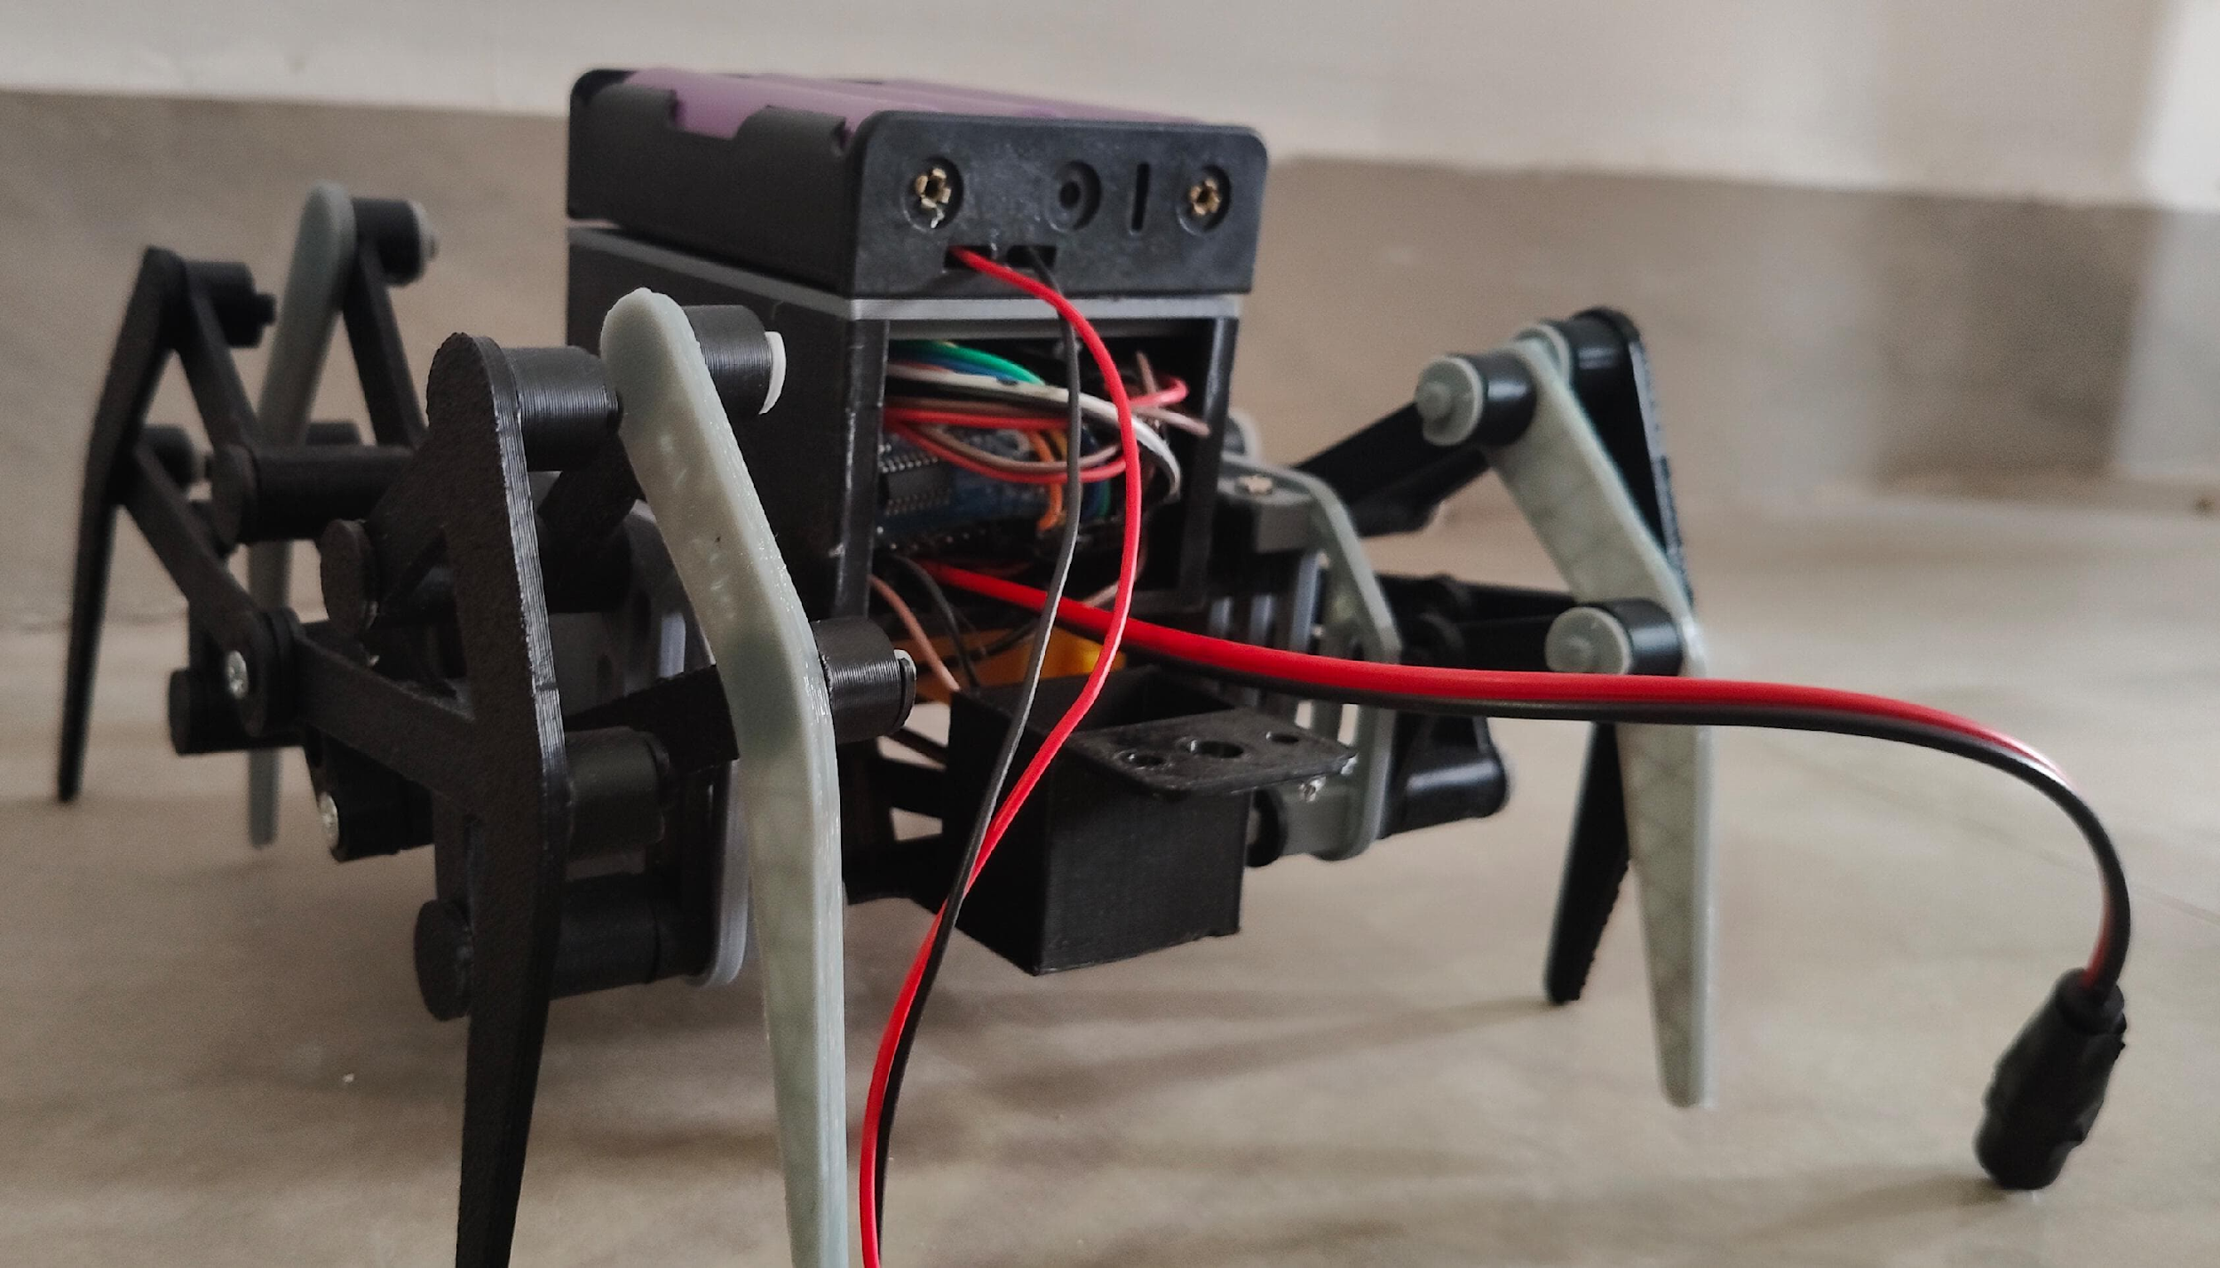
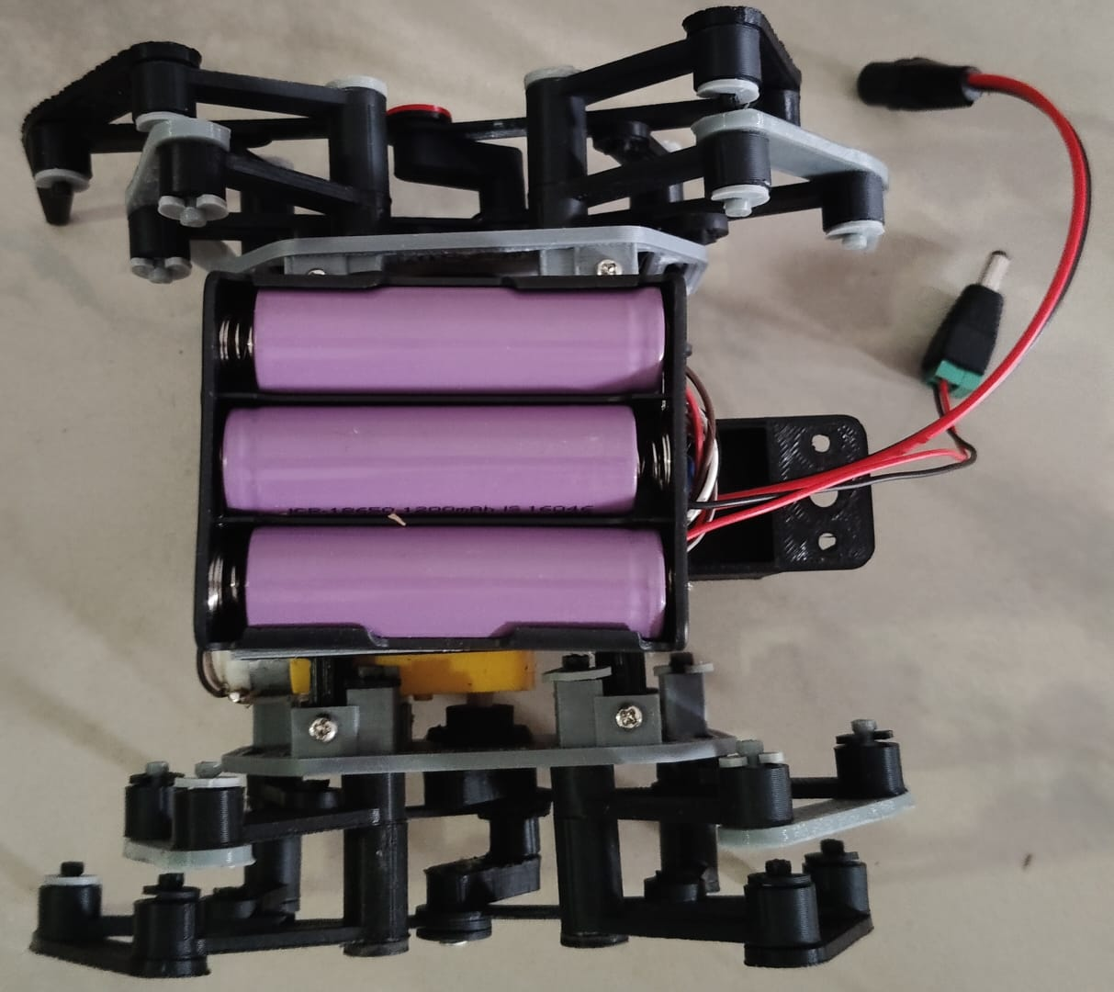
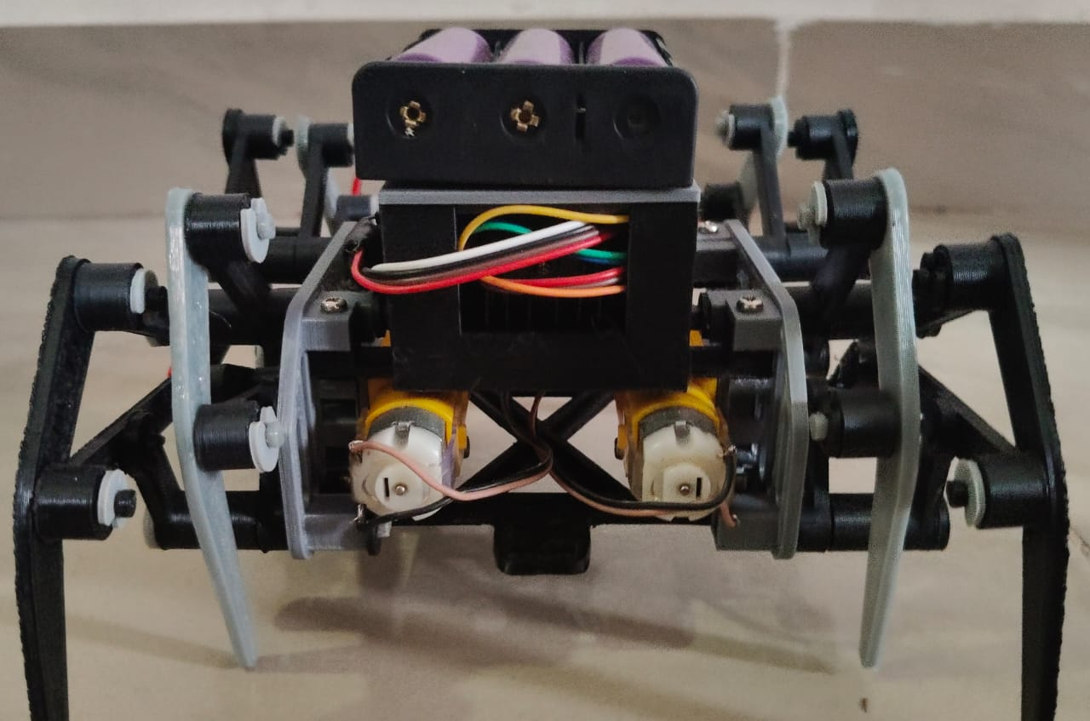
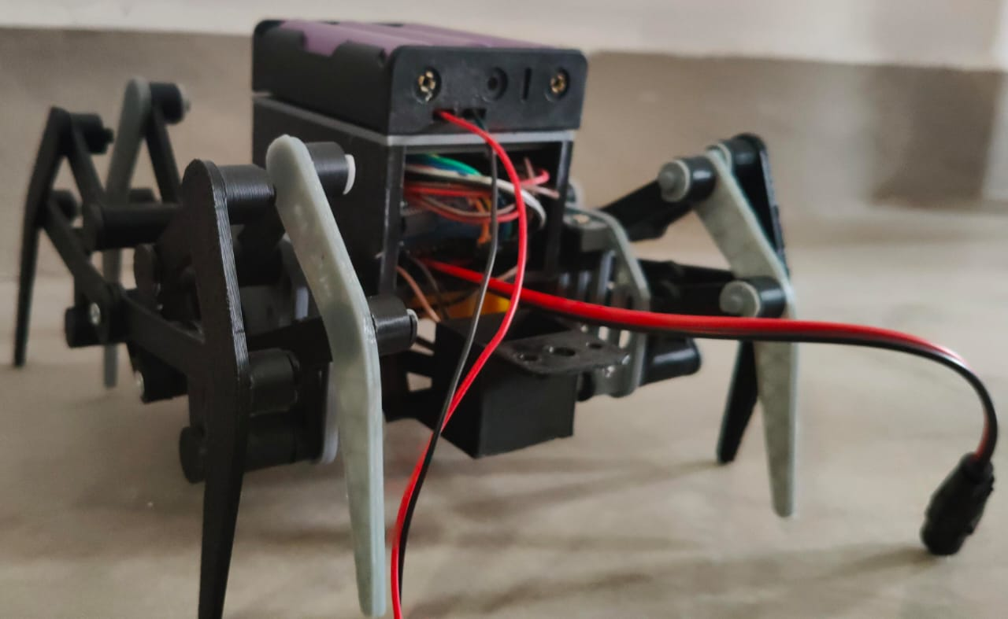
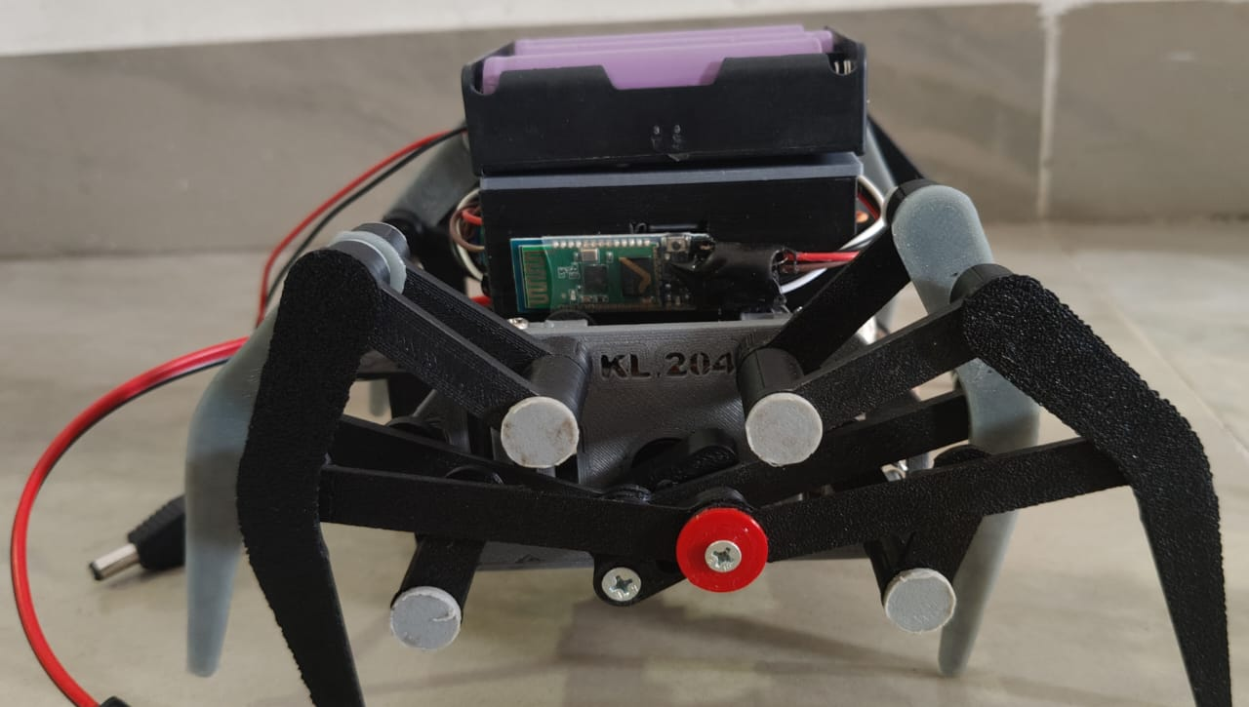
Product Design High Fidelity

Slide 25
Spider Robot Design Mockups
Prototype Development – Build a functional spider robot using 2 BO motors to control 8 legs via a linkage system. Integrate Arduino Nano, HC-05 Bluetooth, and L298N motor driver into a compact and modular chassis.
User Testing & Feedback – Conduct hands-on trials with students, hobbyists, and mentors to assess Bluetooth responsiveness, walking stability, and user control through a mobile app.
Software & Hardware Optimization – Refine Arduino code for smoother leg motion and precise direction control. Improve power delivery, reduce lag, and stabilize Bluetooth signal performance.
Component Sourcing & Cost Analysis – Choose cost-effective and reliable parts like BO motors, batteries, and drivers. Ensure the robot is durable, easy to assemble, and affordable for educational use.
Educational Launch & Promotion – Demonstrate the spider robot in classrooms, tech fairs, and robotics workshops. Promote as a hands-on STEM tool to teach wireless control, embedded systems, and bio-inspired motion.

Slide 26
Future Plan: Spider Robot Project
Mechanical Refinement - Enhance leg linkage design to distribute motion evenly across all 8 legs using just 2 BO motors. Improve stability and movement efficiency for indoor and rough surfaces.
Prototype Finalization - Integrate Arduino Nano, HC-05 Bluetooth, L298N motor driver, and 3x 18650 battery system. Ensure compact, lightweight, and functional assembly for real-time control.
Educational Outreach - Collaborate with schools, colleges, and tech clubs. Use the spider robot as a hands-on tool in STEM education through workshops, exhibitions, and robotics programs.
Cost Optimization - Analyze component cost vs. performance. Explore affordable alternatives to make the robot scalable for mass deployment in schools and DIY robotics kits.
Power Management - Ensure safe power delivery using voltage regulation and buck converters. Optimize battery usage for consistent motor performance and longer operating time.
Feature Expansion - Prepare the robot for future upgrades—such as ultrasonic sensors, obstacle avoidance, or AI-based path following—to transform it into an intelligent platform.

Slide 27
THANK YOU
Chandra Manaswitha

